Slide 1
Chongqing University of Technology
ATAI
Advanced Technique of Artificial Intelligence
Chongqing Unive
Target-adaptive Graph for Cross-target Stance Detection
（WWW-2021)
（WWW 2021）
code :https://github.com/HLT-HITSZ/TPDG
Reported by Zhaoze Gao

Slide 2
Chongqing University of Technology
ATAI
Advanced Technique of Artificial Intelligence
Chongqing University of Technology
1. Introduction
2. Approach
3. Experiments

Slide 3
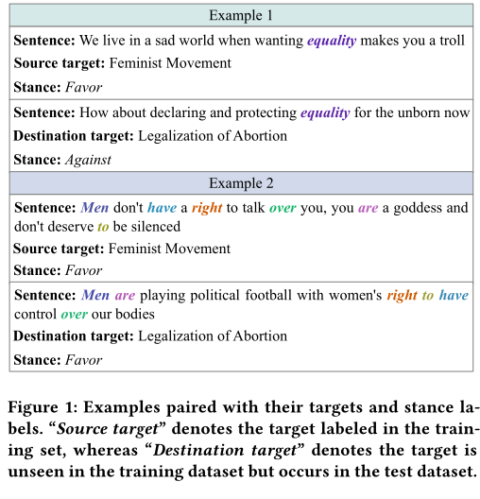
Introduction
in-target words:we regard the words (such as “equality”) whose inherent stances are target-dependent as in-target words.
cross-target words:in Example2, words with colors expressing the same stance regardless of the targets associated with are regarded as target-independent stance expressions.

Slide 4
Introduction
two hypotheses:
• For words exclusively occurred in stance expressions for certain targets and always convey the same stance.modeling and adapting these words for deriving pragmatics information according to their associated targets could improve the
learning of stance representations.
• If the occurrence of words evenly distributes across different targets, then the pragmatics dependencies formed by these words should be target-independent and they will be useful for generating stance representations for any targets including unknown targets.

Slide 5
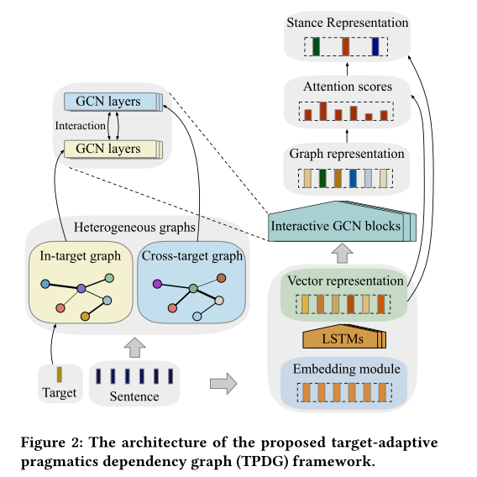
Approach

Slide 6
Approach

Slide 7
Approach
In-target Pragmatics Weight Computation.
Cross-target Pragmatics Weight Computation.
¹Here D_{o} represents all unlabeled data in the datasets, correspondingly it can also be
the destination target dataset, i.e.D_{d}.

Slide 8
Approach
In-target Graph Construction.
Cross-target Graph Construction.

Slide 9
Approach
Interactive GCN Blocks

Slide 10
Approach
Stance Representations
Learning Objective

Slide 11
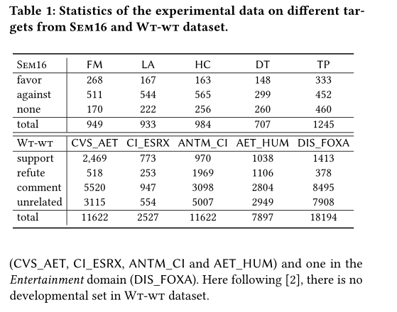
Experiments

Slide 12
Experiments

Slide 13
Experiments

Slide 14
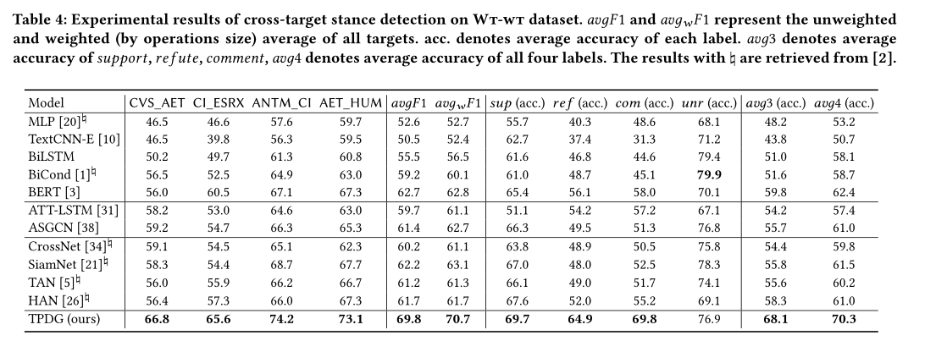
Experiments

Slide 15
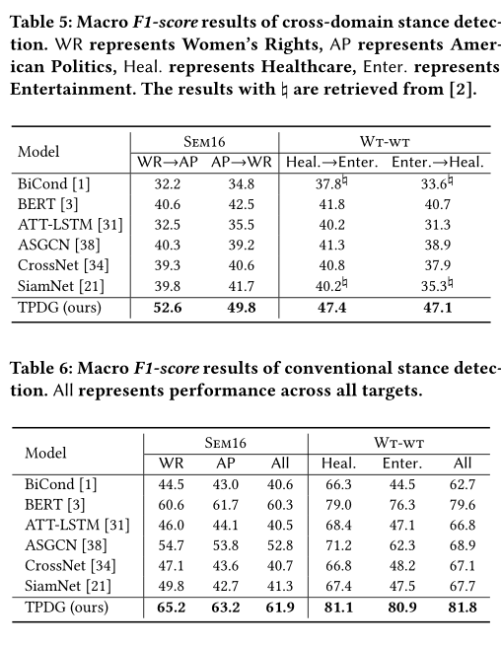
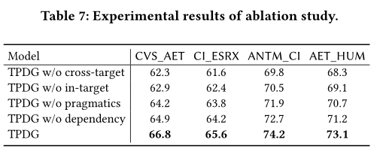
Experiments

Slide 16
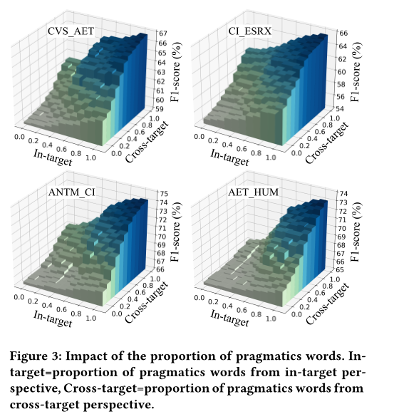
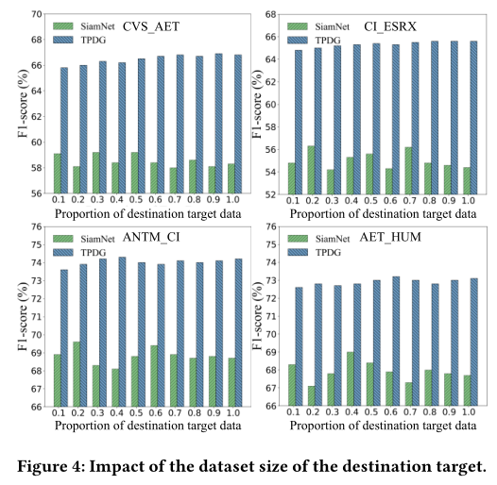
Experiments

Slide 17
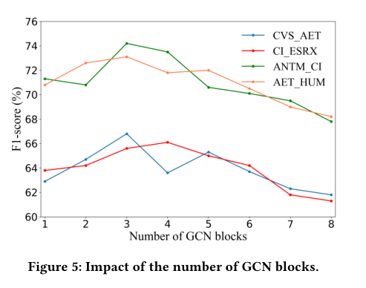
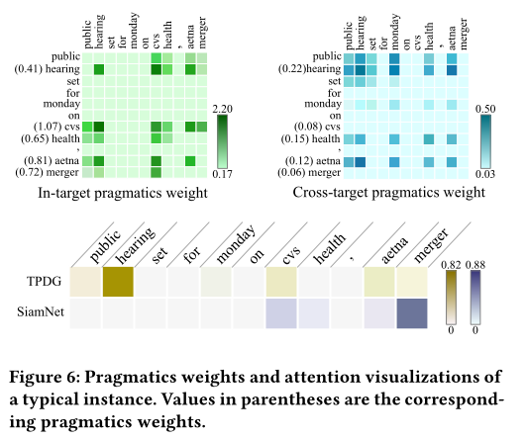
Experiments

Slide 18
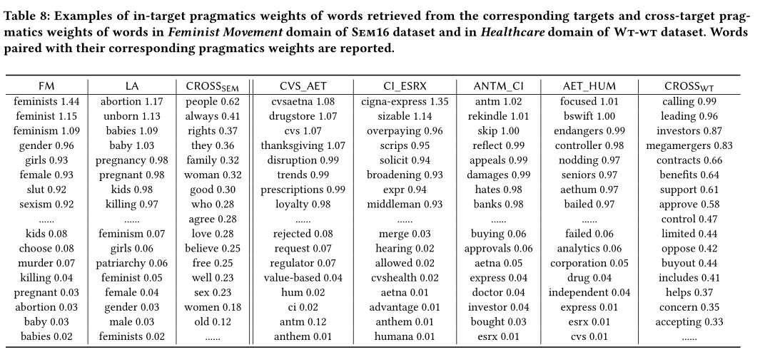
Experiments

Slide 19
Thank you！

